Slide 1
PROJECT CAPACITY ANALYSIS
Guided by:
Siamak Khatibi
Group: SSS
HAILAY GEBRESLASIE GEBREMESKEL
SHRUTHA KEERTHI REDDY NAGAIAHGARI
VENKATA SAI SHRAVYA KATAMANENI

Slide 2
Outline
Introduction
Scenario
Goal/Aim
Task
Dimensioning
Methodology and Analysis
Graphs
Conclusion

Slide 3
Introduction
M/G/1 Queuing model:
This queuing model is an extension of the M/M/1 queue.
Characteristics:
Arrivals are Markovian (modulated by a Poisson process)
Service times have a General distribution.
Single server.

Slide 4
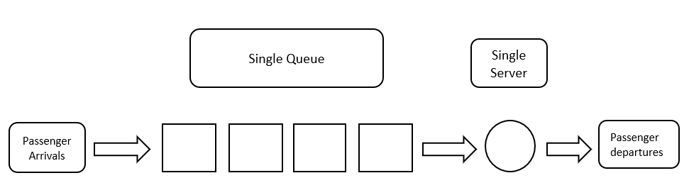
Scenario
An Airport scenario modelled using M/G/1 queuing system.

Slide 5
Goal/Aim
How often can the disturbance occur in the queue? What is the effect of occurred disturbance?
What is the average waiting time in queue? And how is it distributed?
How much time is wasted due to the occurred disturbance?

Slide 6
Task
In a Airport Scenario, Passengers having baggage weight less than or equal to 30KG pass to the next step otherwise, either they must throw some stuff or pay for the extra weight which consumes more time.
Due to the passengers overweight baggage there occurs a disturbance in the system.

Slide 7
Little’s law
ρ =lambda/mu
lambda= Arrival rate
mu=service rate
L_{q} = Number of customers in queue
= ρ^2/(1- ρ)
W_{q}= Mean time a customer spends in the queue
= Lq/λ

Slide 8
Dimensioning:
Lambda = 7 (Arrival rate)
mu = 10 (Service rate)
Baggage weight [25 to 40]

Slide 9
Methodology
Implemented this task in MATLAB
Used a function to import number of arrived passengers (nbrarrived) where the inputs are lambda, mu, and sim_time.
Three events used for deriving the fundamental model of M/G/1 queuing system:
event(1) – arrival
event(2) – departure
event(3) -measurement

Slide 10
The baggage weight is generated using randi in the range of 25 to 40 randi([25,40])
Later we increased the service time when passengers brought baggage more than 30kgs by using this loop.
if curr_customers==1
if bag_current>30
event(2)=exprnd(2*(1/mu))+t;
else
event(2)=exprnd(1/mu)+t;
end
end

Slide 11
Analysis
Q1. How often can the disturbance occur in the queue? What is the effect of occurred disturbance?
If waiting time is less than or equal to expected waiting time, the system is stable or else there is delay in the system, which is caused by the disturbance.

Slide 12
Q2. What is the average waiting time in queue? And how is it distributed?
The mean of all the outcomes of the waiting time of the individual passengers waiting in the queue.
average wait=mean(w)
Where, w is the waiting time of the individual passenger waiting in the queue.
The average wait time is exponentially distributed.

Slide 13
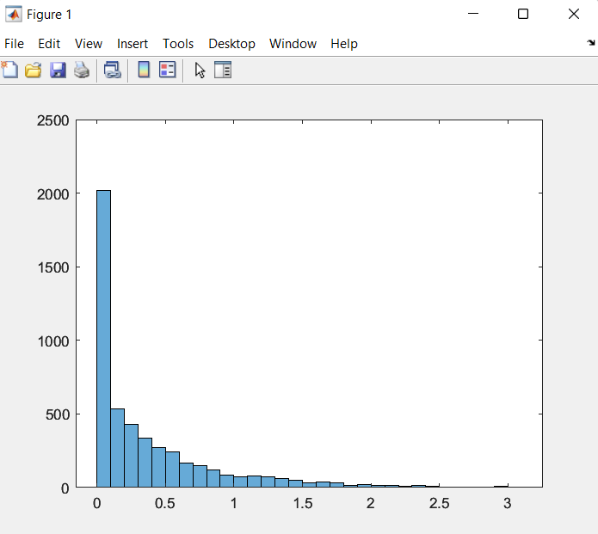
Graphs
Figur
Figure1: Histogram plot of waiting time in the queue

Slide 14
Q3. How much time is wasted due to the occurred disturbance?
The mean of difference of each outcome of the waiting time and expected waiting time.
Time wasted=mean(w-wq)
Where, w is waiting time in the queue.
Wq is the expected waiting time in the queue.

Slide 15
Conclusion
From the above results and graphs we can conclude that when a disturbance occurs due to the overweight baggage, a delay occurs in the queuing system.
Signifying that waiting time of passengers in the queue increases.

Slide 16
THANK YOU

